Slide 1
So what airway and vascular access skills can you perform whilst wearing CBRN-PPE
Nick Castle PhD, MSc ^{(Dist)} DIMC RCS ^{(ED)}
Assistant Executive Director / Head of Professions
Hamad Medical Corporation Ambulance Service

Slide 2
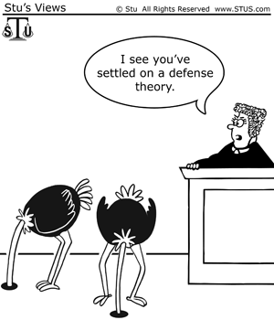
UK CBRN capability pre-2007
Very limited with no structured health service CBRN capabilities and no capacity for on scene clinical treatment...

Slide 3
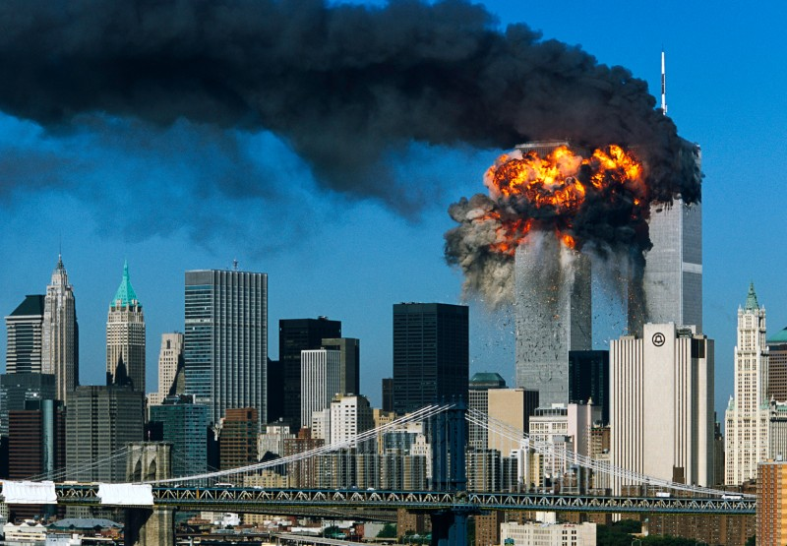
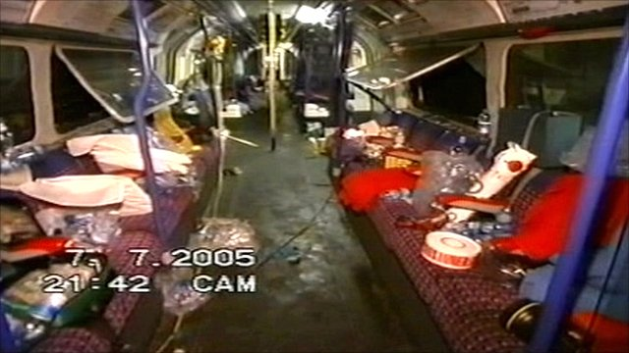
CBRN PPE is issued to the UK National Health Service

Slide 4
As to save a life... You must protect a life

Slide 5
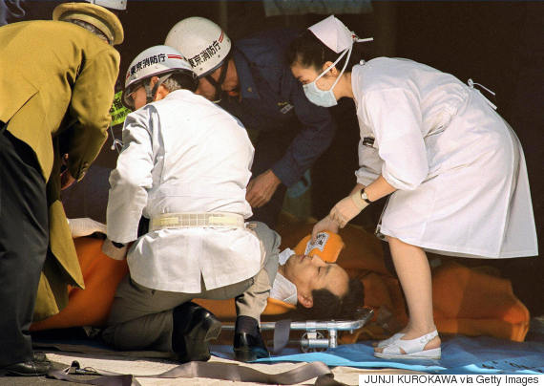
The lessons from Tokyo..!
Numerous critically ill patients (cardiac arrest, seizures, respiratory arrest) survived due to medical intervention…
One hospital >640 patients in 2 hours with 5 serious casualties – two died but three survived. 25% of hospital staff contaminated with some staff requiring hospital admission.

Slide 6
But are we able to treat casualties...
No peer-reviewed data on treating patients whilst wearing NHS CBRN-PPE… limited non military data using civilian

Slide 7
So what to do...
Run a series of randomised control crossover trials supported by qualitative interviewees looking at
- Vascular access and drug
administration
- Airway management
- Role of skill repetition
- Impact of prior experience

Slide 8
VASCULAR ACCESS: IO verses IV for vascular access
mean 95% range
IO
No PPE 19.4s 18.8-20.1 11-37
1) PPE 36 33.5-38.4 18-100
2) PPE 29.8 28.4-31.2 19-89
IV
No PPE 40.8s 38.1-42.7 19-110
1) PPE 129.6 119.7-136 48.488
2) PPE 95.8 90-101.7 42-251
Therefore despite IV access being the most commonly performed skill in routine day-to-day practice it was slower than IO access. Plus less successful.

Slide 9
So what’s the issue with vascular access

Slide 10
AIRWAY MANAGEMENT: ETT verses LMA for airway management
mean 95% range
LMA
No PPE 17.7 17-18.4 10-33
1) PPE 26.6 25.6-27.6 13-51
2) PPE 21.8 21.1-22.6 6-35
ETT
No PPE 36.1 34.2-38 18-99
1)PPE 67.5 63.3-71.7 28-210
2)PPE 59.4 56-62.7 26-161
100% of all LMA insertions were successful compared
to 89% for the 1st intubation attempt rising to 95% on
the 2nd attempt.

Slide 11
Intubation on the floor was even worse... But the LMA just got better?
Skill | Position | Successful (%) | Mean time (sec) | 95% CI | Range (sec) | Failures (%)
Intubation | Standing 1st | 68 (90.6) | 70.3 | 62.5, 78.0 | 28.1-209.7 | 7 (9.4)
 | Standing 2nd | 72 (96) | 59.1 | 53.2, 64.9 | 25.6-160.7 | 3 (4)
 | Floor | 55 (73.3) | 100.7 | 88.4, 113.0 | 38.8-209.7 | 20 (26.6)
LMA | Standing 1st | 75 (100) | 25.7 | 23.8, 27.6 | 12.3-51 | 0
 | Standing 2nd | 75 (100) | 21.5 | 20.1, 22.9 | 6.1-38.1 | 0
 | Floor | 75 (100) | 20.9 | 19.5, 22.4 | 10.3-38.1 | 0
Too quote a consultant anaesthetist... ‘the patient would be dead before you successfully intubate them on the floor!’

Slide 12
So what is the issue...

Slide 13
What about if you use different positions on the floor, verses intubating on a trolley...
Position | CBRN Suit Used? | Total successful attempts | Mean (secs) | SD | 95% CI for mean | Total ETT resulting in oesophageal placement (as a %)
Ambulance Trolley | No | 47 (98%) | 30.04 | 7.18 | (27.95, 32.12) | Total 1 (2%)
 | Yes | 48 (100%) | 39.42 | 9.44 | (36.68, 42.16) | Total 0 (0%)
Lying | No | 46 (96%) | 31.37 | 9.10 | (28.67, 34.07) | Total 1 (2%)
 | Yes | 30 (62.5%) | 56.07 | 19.68 | (48.72, 63.41) | Total 9 (18.7%)
Kneeling | No | 47 (98%) | 29.02 | 6.65 | (27.06, 30.97) | Total 1 (2%)
 | Yes | 39 (81%) | 42.56 | 11.52 | (38.83, 46.29) | Total 5 (10.4)
Sitting | No | 47 (98%) | 30.14 | 13.41 | (26.20, 34.08) | Total 1 (2%)
 | Yes | 40 (83%) | 48.15 | 29.27 | (38.79, 57.51) | Total 6 (12.5%)
Take home message... Avoid intubating on the floor whilst wearing CBRN-PPE

Slide 14
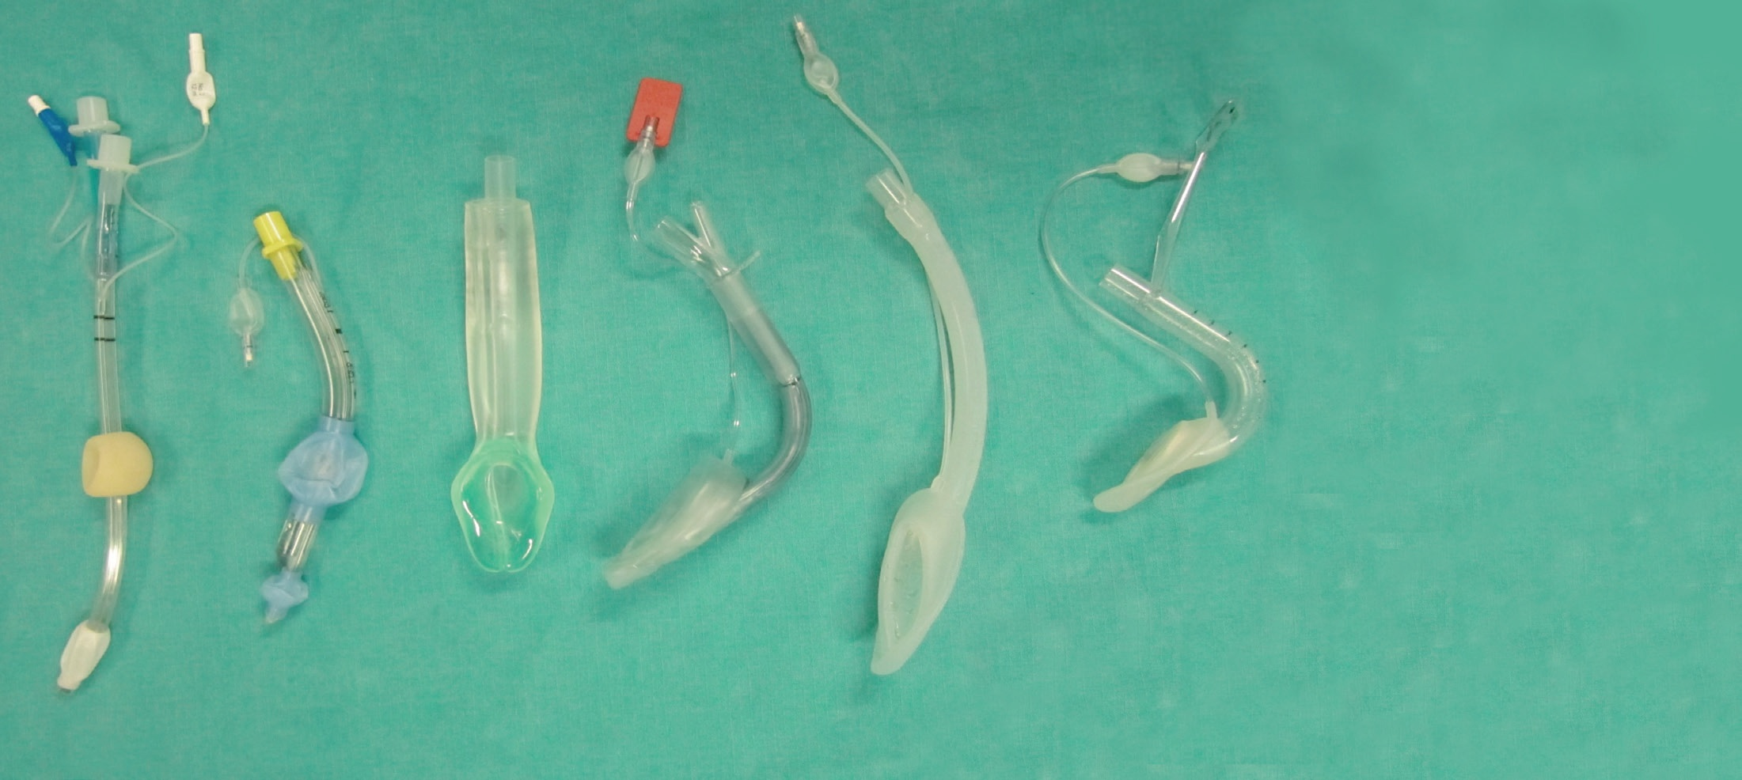
What about other supraglottic airways...
Key
A = Combitube
B = LTA
C = Igel
D = PLMA
E = LMA
F = ILMA

Slide 15
Supraglottic airways not all the same
CBRN-PPE worn | Device | Completion of insertion (measured in seconds)
 |  | 15s | 30s | 45s | 60s | 90s | 120s
NO | LMA | 1.7% | 56.9% | 94.8% | 98.3% | 100% | 100%
 | PLMA | 5.2% | 79.3% | 96.6% | 100% | 100% | 100%
 | Igel | 81.0% | 100% | 100% | 100% | 100% | 100%
 | LTA | 8.6% | 91.4% | 100 % | 100% | 100% | 100%
 | Combitube | 1.7% | 37.9% | 72.4% | 96.6% | 96.6% | 96.6%
 | Fastrack*/ILMA | 3.4% | 58.6% | 94.8% | 98.3% | 100% | 100%
YES | LMA | 0.0% | 10.3% | 46.6% | 81.0% | 94.8% | 100%
 | PLMA | 0.0% | 6.9% | 65.5% | 89.7% | 98.3% | 98.3%
 | Igel | 32.8% | 94.8% | 98.3% | 100% | 100% | 100%
 | LTA | 0.0% | 27.6% | 79.3% | 94.8% | 100% | 100%
 | Combitube | 0.0% | 3.4% | 19.0% | 43.1% | 81.0% | 94.8%
 | Fastrack*/ILMA | 0.0% | 3.4% | 44.8% | 74.1% | 96.6% | 100%

Slide 16
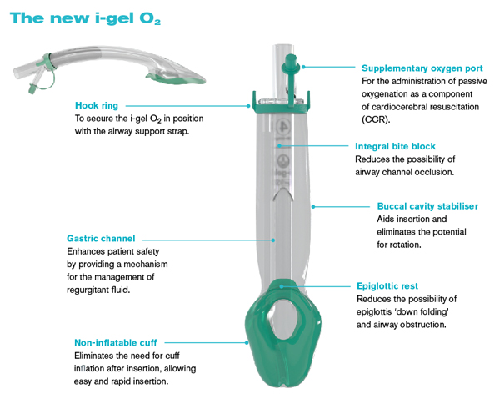
Why is the Igel so much faster
No need for a syringe
Easy to grip, hold and insert
Its big and bulky making it ideal for use whilst wearing thick gloves

Slide 17
What about intubation aids...

Slide 18
Intubation aids, a variable feast
Device | CBRN suit used? | Number of abandoned intubations | Number of oesophageal intubations | Number of successful intubations | For successful intubations only
 |  |  |  |  | Mean (seconds) | Standard Deviation | 95% CI for mean
Standard | No | 0 (0.0%) | 0 (0.0%) | 66 (100.0%) | 30.8 | 8.5 | (28.7, 32.9)
 | Yes | 0 (0.0%) | 5 (7.6%) | 61 (92.4%) | 49.6 | 20.9 | (44.2, 54.9)
Stylet | No | 0 (0.0%) | 0 (0.0%) | 66 (100.0%) | 34.4 | 9.9 | (32.0, 36.9)
 | Yes | 0 (0.0%) | 5 (7.6%) | 61 (92.4%) | 50.9 | 17.0 | (46.6, 55.3)
Bougie | No | 1 (1.5%) | 0 (0.0%) | 65 (98.5%) | 41.9 | 11.0 | (39.1, 44.6)
 | Yes | 2 (3.0%) | 3 (4.5%) | 61 (92.4%) | 58.4 | 20.0 | (53.3, 63.5)
ILMA | No | 0 (0.0%) | 0 (0.0%) | 66 (100.0%) | 41.6 | 13.9 | (38.2, 45.1)
 | Yes | 1 (1.5%) | 1 (1.5%) | 64 (97.0%) | 61.0 | 19.6 | (56.1, 65.9)
Airtraq™ | No | 0 (0.0%) | 4 (6.1%) | 62 (93.9%) | 44.9 | 15.2 | (41.0, 48.7)
 | Yes | 2 (3.0%) | 4 (6.1%) | 60 (90.9%) | 69.4 | 38.4 | (59.5, 79.3)
McCoy™ | No | 1 (1.5%) | 0 (0.0%) | 65 (98.5%) | 36.1 | 12.2 | (33.1, 39.2)
 | Yes | 4 (6.1%) | 8 (12.1%) | 54 (81.8%) | 50.8 | 15.6 | (46.6, 55.1)

Slide 19
So what happened to the bougie...
The bougie mandates the retention of finger-thumb dexterity. Plus ideally its a two person technique.
Handling the bougie was hampered by the CBRN gloves.

Slide 20
Is the intubating LMA the ideal device?

Slide 21
ILMA a new role
Initially use the ILMA as a supraglottic airway to commence ventilation...
Then once pre-oxygenated consider intubating via the ILMA.
A change in practice is recommended... Leave the ILMA in situ once you have intubated... Reduces the risk of accidental extubation.

Slide 22
Dose the experience of the clinician make a difference
Anaesthetists were fastest at intubation and IV access
Emergency nurses were fastest at drawing up drugs
Prehospital clinicians were fastest at intubation on the floor
Consultants were faster than trainees/specialists.
The frequency that a clinician performed a skill, with in their day-to-day practice, influenced the speed they completed this skill whilst wearing CBRN-PPE.

Slide 23
Are the lessons transferable
The make of the PPE is not the issue but…
Gloves/dexterity
Vision

Slide 24
Key findings...
Low dexterity skills are easier to use.
IO access should be the route of choice in the immediate management of the critically ill CBRN casualties.
CBRN-PPE training should include clinical skill practice.
The most experienced clinician, if available should performed skills whilst wearing CBRN-PPE.
IF you are going to intubate ensure the patient is in the optimal position.
The Igel offers rapid airway control and the ILMA is a potential ‘multi-use airway device’.
Repetition increases skill performance.
Established devices (e.g. The bougie) may not prove as useful as anticipated when used whilst wearing CBRN-PPE.

Slide 25
THANK YOU FOR LISTENING...

Slide 27
Department of Health ‘thoughts’
Decontamination will take 12 minutes*
No treatment, or limited treatment before decontamination
Herd and decontaminate before transfer to hospital
‘Hospitals’ may have to decontaminate walking wounded and the worried well
That means the 5th patient, non-self caring, will wait 1 hour if using the hospital tent
Can patients wait AND can you actual treat anyone wearing NHS-PPE
This is the GENERAL public, not solders
Umm, lets wait and see!
*Recent evidence now indicates that Sarin and mustard only requires a maximum of 3 minutes of washing for decontamination.

Slide 28
Hospitals are issued with portable decontamination equipment...
Two patients able to self care
Or a single patient requiring assistance

Slide 29
Are intubation aids of any use? Is there an ideal device?
CBRN-PPE worn? | Device | 30 Seconds | 45 seconds | 60 seconds | 90 seconds | 120 seconds | 150 seconds | Eventually
NO | Standard | 34 (52%) | 64 (97%) | 65 (98%) | 66 (100%) | 66 (100%) | 66 (100%) | 66 (100%)
 | Stylet | 21 (32%) | 59 (89%) | 63 (95%) | 66 (100%) | 66 (100%) | 66 (100%) | 66 (100%)
 | Bougie | 6 (9%) | 46 (70%) | 61 (92%) | 65 (98%) | 65 (98%) | 65 (98%) | 65 (98%)
 | ILMA | 12 (18%) | 48 (73%) | 61 (92%) | 65 (98%) | 66 (100%) | 66 (100%) | 66 (100%)
 | Airtraq™ | 7 (11%) | 36 (55%) | 53 (80%) | 61 (92%) | 62 (94%) | 62 (94%) | 62 (94%)
 | McCoy™ | 19 (29%) | 57 (86%) | 61 (92%) | 65 (98%) | 65 (98%) | 65 (98%) | 65 (98%)
YES | Standard | 4 (6%) | 33 (50%) | 50 (76%) | 57 (86%) | 60 (91%) | 61 (92%) | 61 (92%)
 | Stylet | 1 (2%) | 28 (42%) | 48 (73%) | 58 (88%) | 61 (92%) | 61 (92%) | 61 (92%)
 | Bougie | 0 (0%) | 15 (23%) | 38 (58%) | 55 (83%) | 60 (91%) | 61 (92%) | 61 (92%)
 | ILMA | 0 (0%) | 10 (15%) | 39 (59%) | 58 (88%) | 63 (95%) | 64 (97%) | 64 (97%)
 | Airtraq™ | 1 (2%) | 18 (27%) | 33 (50%) | 50 (76%) | 53 (80%) | 56 (85%) | 60 (91%)
 | McCoy™ | 0 (0%) | 21 (32%) | 46 (70%) | 52 (79%) | 53 (80%) | 54 (82%) | 54 (82%)

Slide 30
ILMA as a supraglottic airway...
CBRN-PPE worn | Device | Completion of insertion (measured in seconds)
 |  | 15s | 30s | 45s | 60s | 90s | 120s
NO | LMA | 1.7% | 56.9% | 94.8% | 98.3% | 100% | 100%
 | PLMA | 5.2% | 79.3% | 96.6% | 100% | 100% | 100%
 | Igel | 81.0% | 100% | 100% | 100% | 100% | 100%
 | LTA | 8.6% | 91.4% | 100 % | 100% | 100% | 100%
 | Combitube | 1.7% | 37.9% | 72.4% | 96.6% | 96.6% | 96.6%
 | Fastrack*/ILMA | 3.4% | 58.6% | 94.8% | 98.3% | 100% | 100%
YES | LMA | 0.0% | 10.3% | 46.6% | 81.0% | 94.8% | 100%
 | PLMA | 0.0% | 6.9% | 65.5% | 89.7% | 98.3% | 98.3%
 | Igel | 32.8% | 94.8% | 98.3% | 100% | 100% | 100%
 | LTA | 0.0% | 27.6% | 79.3% | 94.8% | 100% | 100%
 | Combitube | 0.0% | 3.4% | 19.0% | 43.1% | 81.0% | 94.8%
 | Fastrack*/ILMA | 0.0% | 3.4% | 44.8% | 74.1% | 96.6% | 100%

Slide 31
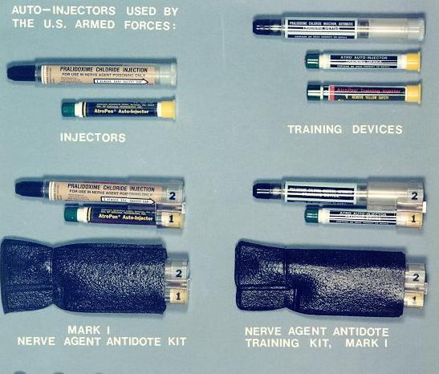
What about IM...
Pros of auto-injector
Cons of auto-injector
Easy to administer
Fast to administer
Fixed dosing regime (3-in-1)
Atropine
Diazepam
Pralidoxime
Well established
Risk of injury to user
Absorption affected by tissue perfusion
Unable to change the dose of the drugs...
Main issue is speed of onset and lack of
drug dosing variability...

Slide 32
Its all about absorption and time to control symptoms
Time to intramuscular drug administered 78-96 seconds (95% CI) resulting in time to therapeutic levels of benzodiazepine = 600 seconds following intramuscular injection.
Therefore by combining 78 seconds with 600 seconds the minimum time to onset of therapeutic action following an intramuscular injection would be >11 minutes from start of procedure (e.g. picking-up syringe).
Time to intravenous access obtained 193-247 seconds (95% CI). Time to therapeutic levels of benzodiazepine 200 seconds following intravenous injection.
Therefore by combining 193 seconds to 100 seconds the minimum time to onset of therapeutic action following an intravenous injection would <5 minutes from start of procedure.
Therefore intravenous/intraosseous, drugs would achieve therapeutic levels at least 6 minutes faster than the same drug administered intramuscularly.
Data based on timings presented by MacDonald et al and Eisenkraft et al.

Slide 33
Intubating LMA as an intubating aid
Device | CBRN suit used? | Number of abandoned intubations | Number of oesophageal intubations | Number of successful intubations | For successful intubations only
 |  |  |  |  | Mean (seconds) | Standard Deviation | 95% CI for mean
Standard | No | 0 (0.0%) | 0 (0.0%) | 66 (100.0%) | 30.8 | 8.5 | (28.7, 32.9)
 | Yes | 0 (0.0%) | 5 (7.6%) | 61 (92.4%) | 49.6 | 20.9 | (44.2, 54.9)
Stylet | No | 0 (0.0%) | 0 (0.0%) | 66 (100.0%) | 34.4 | 9.9 | (32.0, 36.9)
 | Yes | 0 (0.0%) | 5 (7.6%) | 61 (92.4%) | 50.9 | 17.0 | (46.6, 55.3)
Bougie | No | 1 (1.5%) | 0 (0.0%) | 65 (98.5%) | 41.9 | 11.0 | (39.1, 44.6)
 | Yes | 2 (3.0%) | 3 (4.5%) | 61 (92.4%) | 58.4 | 20.0 | (53.3, 63.5)
ILMA | No | 0 (0.0%) | 0 (0.0%) | 66 (100.0%) | 41.6 | 13.9 | (38.2, 45.1)
 | Yes | 1 (1.5%) | 1 (1.5%) | 64 (97.0%) | 61.0 | 19.6 | (56.1, 65.9)
Airtraq™ | No | 0 (0.0%) | 4 (6.1%) | 62 (93.9%) | 44.9 | 15.2 | (41.0, 48.7)
 | Yes | 2 (3.0%) | 4 (6.1%) | 60 (90.9%) | 69.4 | 38.4 | (59.5, 79.3)
McCoy™ | No | 1 (1.5%) | 0 (0.0%) | 65 (98.5%) | 36.1 | 12.2 | (33.1, 39.2)
 | Yes | 4 (6.1%) | 8 (12.1%) | 54 (81.8%) | 50.8 | 15.6 | (46.6, 55.1)

